Slide 1
Solving linear equations where brackets are used
Solving linear equations

Slide 2
how to use Oak lessons

Slide 3
I can recognise that there is more than one way to remove a bracket when solving an equation.

Slide 4
An equation shows two expressions that are equal to each other.

Slide 5

Solving linear equations where brackets are used
Using reciprocals to solve equations with brackets
Efficient methods to solve equations

Slide 6
Using reciprocals to solve equations with brackets
When we see equations with brackets we can expand the brackets to solve.
7(y + 1) | = | 35
7y + 7 | = | 35
7y | = | 28
y | = | 4
7(y + 1) | = | 35
7(y + 1) | = | 35
7y + 7 | = | 35
7 × y + 7 × 1 = 7y + 7
This format looks very familiar. From here we can solve by manipulating.
Check: 7((4) + 1) = 7(5) = 35

Slide 7
Using reciprocals to solve equations with brackets
3(6x + 2) | = | 60
18x + 6 | = | 60
18x | = | 54
x | = | 3
3(6x + 2) | = | 60
3(6x + 2) | = | 60
18x + 6 | = | 60
Solve:
18 | = | 6(2x − 5)
Solve:
18 | = | 12x − 30
48 | = | 12x
x | = | 4
5(x + 2) | = | 2(5x − 10)
5x + 10 | = | 10x − 20
30 | = | 5x
x | = | 6
5(x + 2) | = | 2(5x − 10)
5(x + 2) | = | 2(5x − 10)
5x + 10 | = | 10x − 20
4(x + 3) | = | 3(3x − 1)
4x + 12 | = | 9x − 3
15 | = | 5x
x | = | 3

Slide 8
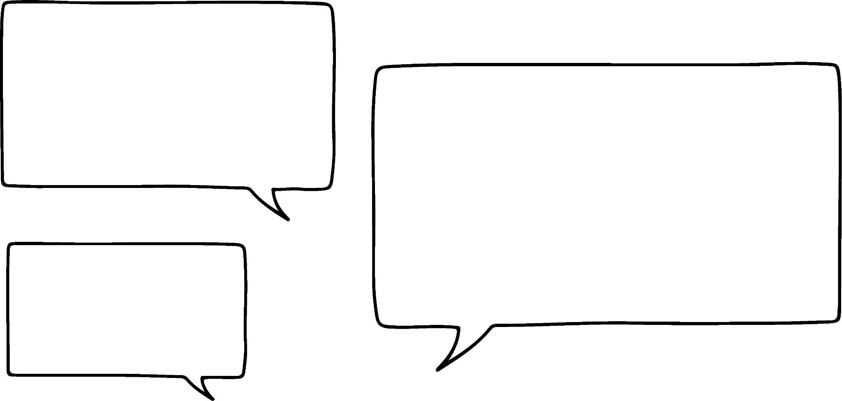

Using reciprocals to solve equations with brackets
Sam has spotted something.
7(y + 1) | = | 35
7y + 7 | = | 35
7y | = | 28
y | = | 4
I can see a quicker way to solve that one! Just divide by 7
7(y + 1) | = | 35
7(y + 1) | = | 35
7y + 7 | = | 35
Can you see what Sam has spotted?
7 is a common factor on both sides.

Slide 9
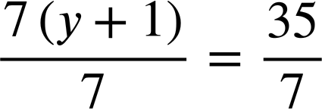
Using reciprocals to solve equations with brackets
Where we see common factors dividing by the coefficient of the bracket could be the quickest solution.
7(y + 1) | = | 35
7y + 7 | = | 35
7y | = | 28
y | = | 4
7(y + 1) | = | 35
7(y + 1) | = | 35
7y + 7 | = | 35
7(y + 1) | = | 35
The common factor is 7, divide both sides by 7
y + 1 | = | 5
y | = | 4
y + 1 | = | 5
This format is now very simple to solve.

Slide 10

Using reciprocals to solve equations with brackets
Where we see common factors dividing by the coefficient of the bracket could be the quickest solution.
This step is the same as multiplying both sides by
7(y + 1) | = | 35
y + 1 | = | 5
y | = | 4
y + 1 | = | 5
is the reciprocal of 7,
hence you might see this called ‘Using the reciprocal to solve’.

Slide 11

Using reciprocals to solve equations with brackets
When solving equations with brackets we have to expand the brackets first.
You always expand the brackets first.
We don’t have to. It might be more efficient to multiply by the reciprocal if we have common factors on both sides.

Slide 12
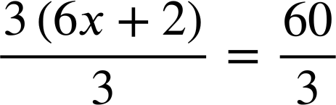
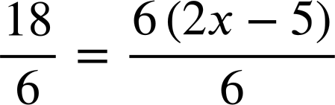
Using reciprocals to solve equations with brackets
Use the reciprocal to solve:
Use the reciprocal to solve:
3(6x + 2) | = | 60
3(6x + 2) | = | 60
18 | = | 6(2x − 5)
6x + 2 | = | 20
6x | = | 18
x | = | 3
6x + 2 | = | 20
3 | = | 2x − 5
8 | = | 2x
x | = | 4

Slide 13
Using reciprocals to solve equations with brackets
1) Solve these equations in two different ways. Firstly, by expanding the bracket as a first step. Secondly, by multiplying by the reciprocal.
2(x + 7) | = | 30
2(x + 7) | = | 30
a)
b)
21 | = | 7(2x + 7)
21 | = | 7(2x + 7)
2) Solve by expanding first:
5(x − 1) | = | 3(3x − 11)
3(x − 1) | = | 5(3x − 11)
5(x − 1) | = | 3(3x − 11)
a)
b)

Slide 14


Using reciprocals to solve equations with brackets
3) Laura and Izzy have solved an equation by removing the brackets.
5(x − 10) | = | 45
5x − 10 | = | 45
5x | = | 55
x | = | 11
5(x − 10) | = | 45
x − 10 | = | 9
x | = | 19
Izzy
Laura
Only one pupil is correct.
Write a sentence explaining why the right method worked and write a sentence explaining what went wrong in the other one.

Slide 15
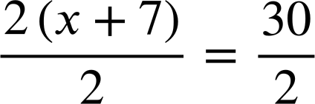
Using reciprocals to solve equations with brackets
1) Solve these equations in two different ways. Firstly, by expanding the bracket as a first step. Secondly, by multiplying by the reciprocal.
2(x + 7) | = | 30
2x + 14 | = | 30
2x | = | 16
x | = | 8
2(x + 7) | = | 30
2(x + 7) | = | 30
2x + 14 | = | 30
2(x + 7) | = | 30
a)
x + 7 | = | 15
x | = | 8

Slide 16
Using reciprocals to solve equations with brackets
1) Solve these equations in two different ways. Firstly, by expanding the bracket as a first step. Secondly, by multiplying by the reciprocal.
2(x + 7) | = | 30
2x + 14 | = | 30
2x | = | 16
x | = | 8
2(x + 7) | = | 30
2(x + 7) | = | 30
2x + 14 | = | 30
2(x + 7) | = | 30
a)
x + 7 | = | 15
x | = | 8
When written like this you can see that using the reciprocal was only two-steps to solving making it the more efficient method on this occasion.

Slide 17
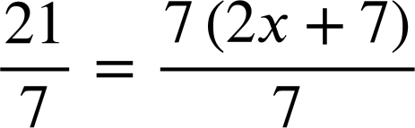
Using reciprocals to solve equations with brackets
1) Solve these equations in two different ways. Firstly, by expanding the bracket as a first step. Secondly, by multiplying by the reciprocal.
21 | = | 7(2x + 7)
21 | = | 14x + 49
21 | = | 7(2x + 7)
21 | = | 14x + 49
−28 | = | 14x
x | = | −2
b)
21 | = | 7(2x + 7)
21 | = | 7(2x + 7)
3 | = | 2x + 7
−4 | = | 2x
x | = | −2
Using the reciprocal gave us a simpler equation to solve upon reaching the form ax + b = c

Slide 18
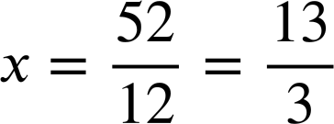
Using reciprocals to solve equations with brackets
2) Solve by expanding first:
5(x − 1) | = | 3(3x − 11)
5x − 5 | = | 9x − 33
−5 | = | 4x − 33
28 | = | 4x
x | = | 7
5(x − 1) | = | 3(3x − 11)
5(x − 1) | = | 3(3x − 11)
5x − 5 | = | 9x − 33
3(x − 1) | = | 5(3x − 11)
3x − 3 | = | 15x − 55
3x + 52 | = | 15x
52 | = | 12x
3(x − 1) | = | 5(3x − 11)
5(x − 1) | = | 3(3x − 11)
3(x − 1) | = | 5(3x − 11)
3x − 3 | = | 15x − 55
a)
b)

Slide 19


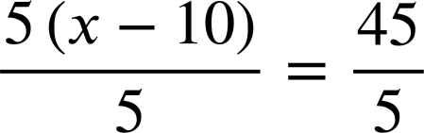

Using reciprocals to solve equations with brackets
3) Laura and Izzy have solved an equation by removing the brackets.
5(x − 10) | = | 45
5x − 10 | = | 45
5x | = | 55
x | = | 11
5(x − 10) | = | 45
x − 10 | = | 9
x | = | 19
Izzy
Laura
Izzy is correct. She has multiplied both sides by the reciprocal
leaves the simple equation

Slide 20
Using reciprocals to solve equations with brackets
3) Laura and Izzy have solved an equation by removing the brackets.
5(x − 10) | = | 45
5x − 10 | = | 45
5x | = | 55
x | = | 11
5(x − 10) | = | 45
x − 10 | = | 9
x | = | 19
Izzy
Laura
Laura is incorrect. She has simply erased the brackets rather than multiplied them out; you have to make sure both terms inside the bracket are multiplied. 5(x − 10) should multiply out to 5x − 50

Slide 21
Solving linear equations where brackets are used
Using reciprocals to solve equations with brackets
Efficient methods to solve equations

Slide 22
Efficient methods to solve equations
Izzy is solving more equations with brackets.
Expanding first:
Multiplying by the reciprocal first:
2(x + 4) | = | 20
2(x + 4) | = | 20
2x + 8 | = | 20
2x | = | 12
x | = | 6
2(x + 4) | = | 20
x + 4 | = | 10
x | = | 6
It seems to me that the reciprocal method is always the quickest way!

Slide 23
Efficient methods to solve equations
Izzy is solving more equations with brackets.
Expanding first:
Multiplying by the reciprocal first:
3(x + 4) | = | 20
3(x + 4) | = | 20
3(x + 4) | = | 20
Here is a different equation.
Do you think Izzy’s statement is correct?
It seems to me that the reciprocal method is always the quickest way!

Slide 24
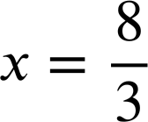
Efficient methods to solve equations
Izzy is solving more equations with brackets.
Expanding first:
Multiplying by the reciprocal first:
3(x + 4) | = | 20
3(x + 4) | = | 20
3x + 12 | = | 20
3x | = | 8
3(x + 4) | = | 20
3(x + 4) | = | 20
It seems to me that the reciprocal method is always the quickest way!

Slide 25
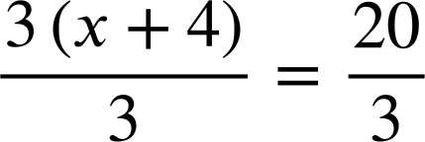
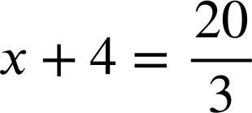
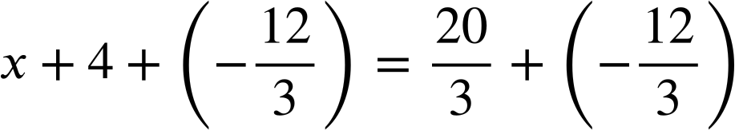
Efficient methods to solve equations
Izzy is solving more equations with brackets.
Expanding first:
Multiplying by the reciprocal first:
3(x + 4) | = | 20
3(x + 4) | = | 20
3x + 12 | = | 20
3x | = | 8
3(x + 4) | = | 20
3(x + 4) | = | 20
There was no common factor so the reciprocal method was less simple this time.

Slide 26


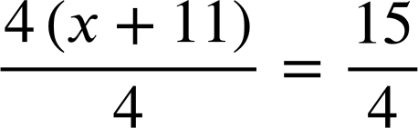


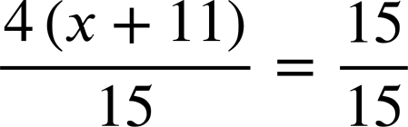
Efficient methods to solve equations
What might be an efficient first step for solving this equation?
Expanding gives us the form ax + b = c with a, b and c all integers.

Slide 27
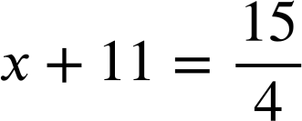
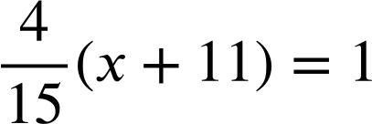
Efficient methods to solve equations
What might be an efficient first step for solving this equation?
It works but gives you non-integer values earlier.
It could be done but would be really inefficient.

Slide 28




Efficient methods to solve equations
Izzy is joined by Aisha to solve this equation.
6(x + 4) | = | 2(x + 8)
6x + 24 | = | 2x + 16
4x | = | −8
x | = | −2
6(x + 4) | = | 2(x + 8)
6(x + 4) | = | 2(x + 8)
I’ll multiply by the reciprocal of the coefficient.
I’ll expand first.

Slide 29
Efficient methods to solve equations
Izzy is joined by Aisha to solve this equation.
6(x + 4) | = | 2(x + 8)
6x + 24 | = | 2x + 16
4x | = | −8
x | = | −2
6(x + 4) | = | 2(x + 8)
6(x + 4) | = | 2(x + 8)
The common factor of 6 and 2 is 2. Try using the reciprocal of that instead.
I’m not sure this is the best way!

Slide 30

Efficient methods to solve equations
Izzy is joined by Aisha to solve this equation.
6(x + 4) | = | 2(x + 8)
6x + 24 | = | 2x + 16
4x | = | −8
x | = | −2
6(x + 4) | = | 2(x + 8)
6(x + 4) | = | 2(x + 8)
3(x + 4) | = | x + 8
3x + 12 | = | x + 8
2x | = | −4
x | = | −2
3(x + 4) | = | x + 8
That was much easier. Thanks Izzy!
The common factor of 6 and 2 is 2. Try using the reciprocal of that instead.

Slide 31
Efficient methods to solve equations
Izzy is joined by Aisha to solve this equation.
6(x + 4) | = | 2(x + 8)
6x + 24 | = | 2x + 16
6(x + 4) | = | 2(x + 8)
6(x + 4) | = | 2(x + 8)
3(x + 4) | = | x + 8
This manipulation didn’t change the fact that we still had to expand to solve but it did give us an equation that was more simple to solve.

Slide 32






Efficient methods to solve equations
Which first step makes this equation more simple?
Possible, just not more simple.
A more simple equation.
Possible, just not more simple.

Slide 33
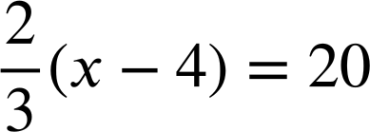
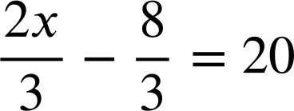
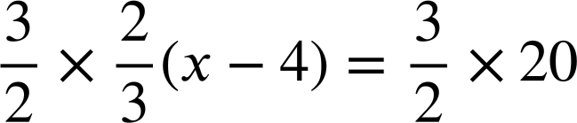
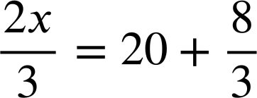

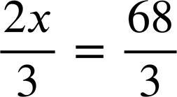


Efficient methods to solve equations
For this equation Izzy expands first and Aisha uses the reciprocal.
Aisha’s method is most efficient this time. When we have a non-integer coefficient multiplying by the reciprocal can be really efficient.

Slide 34









Efficient methods to solve equations
Which first step makes this equation most simple?
The reciprocal of
Some efficiency
Not the reciprocal.
Very inefficient.
Multiplying by the reciprocal is very efficient.

Slide 35
Efficient methods to solve equations
1) Solve this equation using both methods and write a sentence comparing the efficiency of the methods.
Expanding first:
Multiplying by the reciprocal first:
5(x + 13) | = | 40
5(x + 13) | = | 40
2) Solve both of these equations twice using two different methods.
2(x + 6) | = | 10(x − 2)
20(x + 2) | = | 5(7x − 1)
a)
b)

Slide 36


Efficient methods to solve equations
3) Solve:
a)
b)

Slide 37
Efficient methods to solve equations
1) Solve this equation using both methods and write a sentence comparing the efficiency of the methods.
Expanding first:
Multiplying by the reciprocal first:
5(x + 13) | = | 40
5x + 65 | = | 40
5x | = | −25
x | = | −5
5(x + 13) | = | 40
5(x + 13) | = | 40
x + 13 | = | 8
x | = | − 5
You may have written, “For this equation, multiplying by the reciprocal was the most efficient method because in one step it gave us a very simple equation to solve.”

Slide 38
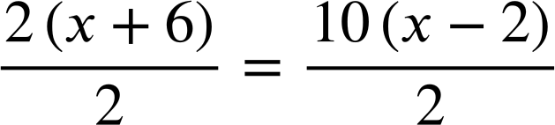
Efficient methods to solve equations
2) Solve both of these equations twice using two different methods.
2(x + 6) | = | 10(x − 2)
2(x + 6) | = | 10(x − 2)
2x + 12 | = | 10x − 20
12 | = | 8x − 20
32 | = | 8x
x | = | 4
2(x + 6) | = | 10(x − 2)
2(x + 6) | = | 10(x − 2)
2x + 12 | = | 10x − 20
2(x + 6) | = | 10(x − 2)
a)
x + 6 | = | 5(x − 2)
x + 6 | = | 5x − 10
16 | = | 4x
x | = | 4
x + 6 | = | 5(x − 2)
The ability to perform multiple methods fluently is very powerful in maths.

Slide 39
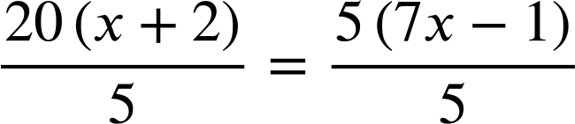
Efficient methods to solve equations
2) Solve both of these equations twice using two different methods.
20(x + 2) | = | 5(7x − 1)
20x + 40 | = | 35x − 5
40 | = | 15x − 5
45 | = | 15x
x | = | 3
20(x + 2) | = | 5(7x − 1)
20(x + 2) | = | 5(7x − 1)
20x + 40 | = | 35x − 5
20(x + 2) | = | 5(7x − 1)
b)
4(x + 2) | = | 7x − 1
4x + 8 | = | 7x − 1
9 | = | 3x
x | = | 3
4(x + 2) | = | 7x − 1

Slide 40

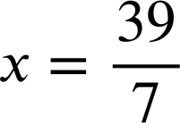
Efficient methods to solve equations
3) Solve:
a)
7x − 4 | = | 35
7x | = | 39
7x − 4 | = | 35
Other methods were available but this is the most efficient one.

Slide 41







Efficient methods to solve equations
3) Solve:
b)
2(5x − 15) | = | 15(x +4)
10x − 30 | = | 15x + 60
−90 | = | 5x
x | = | −18
2(5x − 15) | = | 15(x +4)

Slide 42
Solving linear equations where brackets are used
There is more than one way to solve an equation with brackets.
For example, the equation 17 = 2(y − 8) could be solved by first expanding the bracket out, or alternatively, by multiplying both sides by the reciprocal of 2

Slide 43

© Oak National Academy 2023.
Produced in partnership with Mathematics in Education and Industry.
Licensed on the Open Government Licence v3.0, except where otherwise stated. See Oak terms and conditions.

